Slide 1



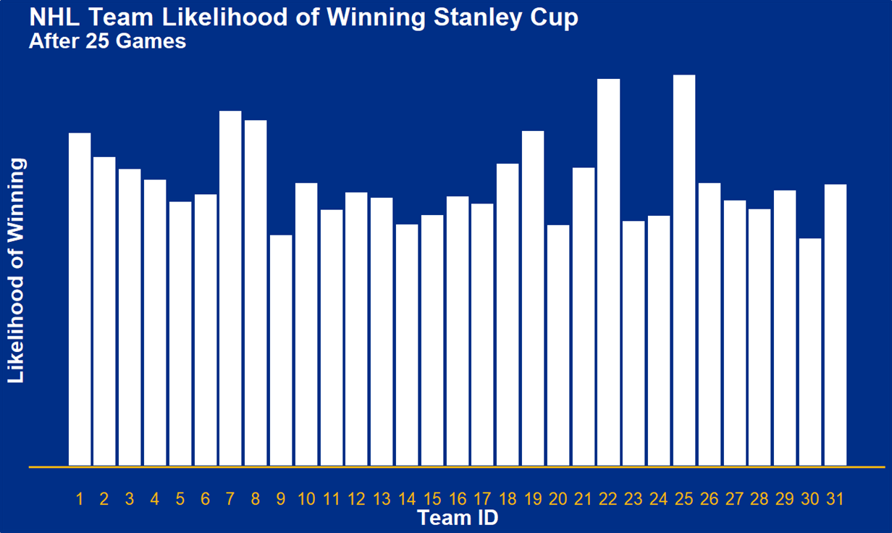
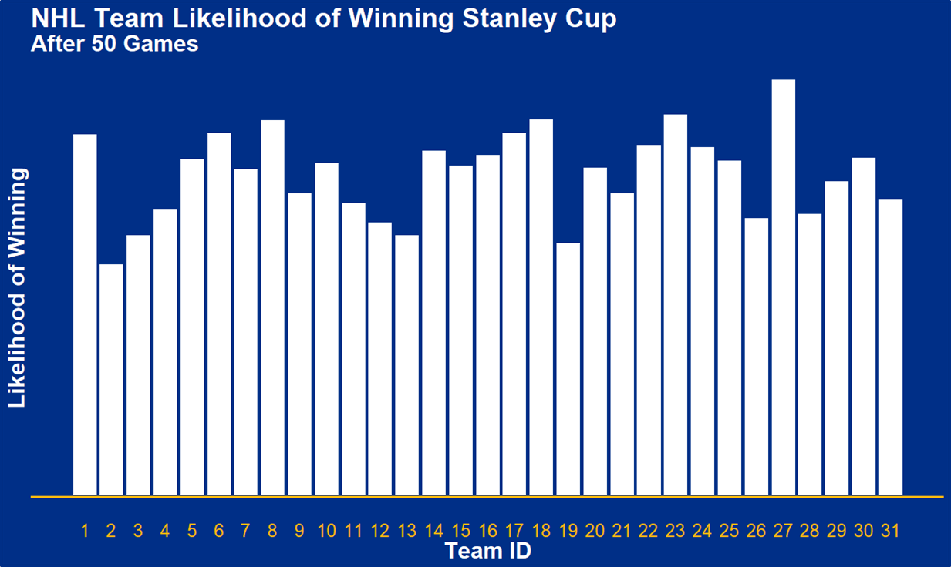



Never Tell Me the Odds!
What were the chances that the St. Louis Blues could go from Second-Last
to Winning the Stanley Cup?
Introduction
Constant Elo Ratings – 3 points in Time
In What Parallel Universe Could the Blues Win?
The National Hockey League comprised 31 teams in the 2018-2019 season. The St. Louis Blues, based out of Missouri, were the team that took home the Stanley Cup after the long playoffs series.
What made the St. Louis Blues winning the Stanley Cup so exceptional was that they were ranked 30th out of 31 teams in the League after their 25th game, which was 14th out of 15 in the Western Conference and 7th out of 7 in the Central Division. From this point, the Blues managed to turn around their season to make it to the playoffs and eventually won the Stanley Cup. By their 50th game they were ranked 20th in the League, 10th in Conference, and 6th in Division. By the end of the regular season, 82 games, they clinched a playoffs position from 3rd in the Division, 5th in Conference, and 11th in League.
But exactly how unlikely was this turn around? After games 25 and 50, what were the St Louis Blues chances of making it to the playoffs and eventually winning the Stanley Cup? How does this compare to their chances at the end of the season? What were the chances of the St Louis Blues winning the Stanley Cup after games 25 and 50? Did this change compared to game 82?
A constant Elo model was used to create ratings for every team at three points in time; after games 25, 50, and 82. No home ice advantage was factored into the model, so the rating formula was:
$$E_{A}=\left(\frac{1}{1+{10}^{\left(−\left(\frac{R_{a}−R_{b}}{400}\right)\right)}}\right)$$
The standard MS Solver was used to find team ratings that minimised the sum of the squares of the differences between predicted results (E above) and the actual results of each match. Data was partitioned twice based on the game numbers of both teams being more than 25 and then 50. All team ratings were centred around 1500.
After game 25, the team rating for the St. Louis Blues was found to be 1,389.5; 31st out of 31 in the League. After game 50, the St. Louis Blues had a team rating of 1472.0, which was 21st out of 31. At the end of the regular season, the team rating for St. Louis was 1535.4, which was 10th out of 31 teams.
The simulations found the likelihood of the St. Louis Blues winning the Stanley Cup from game 25 to be 1/1000. The Blues’ chances improved by game 50, which were 1/500. At the end of the regular season, with a position in the playoffs clinched, their chances were still only 1/200.
Season Structure
Simulation
Unlike many other sports, the NHL doesn’t strictly have rounds. As each team played 82 games in the regular season, this number does not divide evenly into the approximately 26 weeks that the season spans. As such, number of games played was used to calculate ranking position at given points within the season.
The NHL finals series brings together the two conferences within the League; Western and Eastern. The winners of the playoffs series within each conference then play each other in the Stanley Cup finals series. In each finals matchup, both teams play up to seven games, with the team to reach 4 wins progressing to the next stage.
Three simulations were run to match each of the partitions of data and each of the Elo team ratings. Using the ratings determined for games 1 to 25, games from 26 onwards were simulated. Similarly, using the Elo ratings for games 1 to 50, games from 51 onwards were simulated. For these two simulations the final standings, as determined by the simulation, were used to further simulate the finals series. The Elo ratings as determined for the entire regular season were also used to simulate the finals series. As such, three likelihoods were calculated; the likelihood of St. Louis winning the Stanley Cup at game 25, at game 50, and at game 82.
Each of the simulations were run across 5,000 trials. For each game within each trial a number was chosen at random from a uniform distribution between 0 and 1. If this number was lesser than the expected result of the match, Team A was determined to win the simulated game. Conversely, if the value of the random number was greater than the expected value, Team B was determined to win. If the random number was no lesser than 5% less than the expected value, an overtime loss was recorded. This was repeated for each of the remaining games of the regular season and the finals series.
Points were determined for each of the simulated games in the remaining season to align with standard scoring in the NHL. Two points were awarded for a win, zero points for a loss, and one point for an overtime loss. Ties in season points were broken by adjusting points by adding ${Elo_{A}}/{10,000}$ . These season rankings were used to decide the teams that progressed into the finals.
The playoffs series were decided by the same method as above, with expected results compared to a value from random number generator. Each winner progressed to the next stage, and ultimately the final playoffs series.
Limitations and Conclusions
Due to the staggered nature of number of games played across teams, some data was lost when partitioning on game number. For example, if all fixtures from game 25 onwards were filtered out of a data partition, games where Team A were playing their 23rd game and Team B were playing their 26th game were lost; neither considered in the constant Elo rating optimisation nor the partitioned data used to simulate the remaining season. A more effective method for partitioning the data would be based on date coupled with a refining of the season standings scoring method.
The method used for calculating the season standings was too simple for the intended purpose. Points were calculated simply based on whether the team won, lost, or had an overtime loss. This greatly contrasts the season standings scoring method used by the NHL, which is more complex and comprises goals scored differential, games results between tied teams, and season points in the context of number of games played.
The simulations could have also been improved by incorporating a simulation of points scored, which would have assisted with determining season standings (as outlined above) as well as provided a more realistic simulation of the regular season. Overtime losses were based on the difference between a random number and Elo expected results, which reduced the results of the game to a ternary data structure (0, 1, 2). Using a multiple regression model to simulate goals scored by teams would facilitate adding this level of granularity to the simulations.
First Round
Second Round
Conference Finals
Stanley Cup Finals
Conference Finals
Second Round
First Round
1st Atlantic
1st Central
Wild Card Eastern
Wild Card Western
2nd Atlantic
2nd Central
3rd Atlantic
3rd Central
1st Metropolitan
1st Pacific
Wild Card Eastern
Wild Card Western
2nd Metropolitan
2nd Central
3rd Metropolitan
3rd Central

